Slide 1
Literature Survey, Literature Comprehension & Literature Review

Slide 2
Read carefully and critically
The methods used to produce a piece of research are an important indicator of its reliability.
You might assume that all research reports which have been accepted for publication are reliable, but this is not foolproof.
There have been some famous cases of fraudulent research which have successfully fooled the research establishment
Jan Hendrik Schön
High publication rate
Falsified data by presenting identical graphs in two different papers - on different topics.
Andrew Wakefield
Expert in autism
Guilty of conflict of interest (receiving money, owned company which conducted tests)
Highly selective data reporting, unethical treatment of children

Slide 3
Read carefully and critically
False reviewing
When asked by journal editors to suggest names of experts in their field who were not involved in their research, authors suggested names and emails that then forwarded back to their own inboxes.
There have been cases of research withdrawn due to the controversy about the methods used
E.g. Facebook Emotional Contagion http://www.onthemedia.org/story/scholar-asks-facebooks-emotional-contagion-study-be-withdrawn/
Purposely showed users only negative posts from friends’ feeds to test if this would lead to a spread of ‘emotional contagion’ across the network to see if mood could be manipulated
Participants involuntarily enrolled in study, not given an opportunity to remove themselves

Slide 4
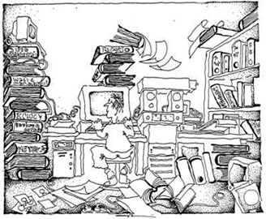
Literature Comprehension
Initially you will find this overwhelming…
You will be presented with lots of with new terminology, models and approaches.
THIS IS PERFECTLY NORMAL

Slide 5
Literature Comprehension
Process of reading and understanding the research found in the survey process.
The first thing to do is to organize your collected research based on themes within your research
Physical piles, folders, tags etc.
Some papers might be about the overall themes and others might be about specific issues.
Also don’t be afraid to ask for help – from your lecturers or other people.

Slide 6
Literature Comprehension
Don’t get overwhelmed by it all
You are learning a new skill through practice
The more papers you read, the less new terms you will be encountering, the more of an expert you will become.
You are also adding to your keyword search list.
The first few papers are the most difficult, once you are over that hurdle, you will find the rest much easier.

Slide 7
Getting started
Look for a review article related to your area
This may mean you have to look for reviews in a broader topic
This will help identify broad issues of concern
This will help you see how your topic is related
Look for articles with ‘techniques’ or ‘applications’ or ‘case study’ in the title
These papers will generally include a review (of varying detail) of a range of techniques and applications
If you are looking at the application of your research area to another area - your search to include databases, journals, conferences etc. related to this area also

Slide 8
How to read a research paper?
You are reading for underlying meaning
The goal of reading is not simply to see what is said, but to understand the bias, assumptions, and perspectives underlying the discussion.
We are trying to understand the author’s view of the world
Your Objectives are to:
Understand the problem discussed
Understand the proposed solution
Understand competing approaches / designs that could have been used
Evaluate the paper in terms of
The area you are working in
Your work in particular

Slide 9
Types of Reading
Scanning
Casting your eye over
Looking for particular points
Skimming
Rapid, surface
Gaining a general impression
Receptive
‘Listening’ to the author
Steady, easy pace
Reflective
Think carefully about what you are reading
Analysis, Evaluation, Judgement
Collection
Scan and Skim
Understanding
Active Receptive Reflective
Review
Reflective

Slide 10
Types of Reading
Collection
Scan and Skim
You may need to re-read sentences, look up terminology etc.
Understanding
Active Receptive Reflective
You may need to re-read sections of papers, check for agreements, dis-agreements etc.
Review
Reflective

Slide 11
SQ3R Reading Technique
Survey
Get the general idea
Question
What questions would you like the text to answer?
Read
If you think it is relevant to your work
Recall
Try to recall the main points after reading (and record)
Review
To confirm you have understood and collected the main points

Slide 12
Survey (scan and skim)
Objective: Establish if work is relevant to your research
Title
(If relevant look at TOC, Keywords)
Abstract
Make decision to read/discard
Section headings
Conclusion
Introduction
Bibliography

Slide 13
Q & R: Question and Read
Question
Read
To Help You To Read actively
Try to relate to
Experience
Other work
Your thinking
Formulate questions you think the text will/should answer
Connect
To your work
Other work
Your experience
Take notes
Break large texts into smaller more manageable chunks and read as separate texts
Literature
Experiment
Conclusions…

Slide 14
Recall and Review
After each reading
Write a short paragraph (one-three sentences) summarising what you have read
Write a short paragraph (one-three sentences) about what you think this signals for your work
(can be combined)

Slide 15
The Three Pass Approach – First Pass
Source: “How to Read a Paper” by (Keshav, 2007)
Objective: To decide if the paper is worth a reflective read
Aim for 5-10 mins
Quick scan to get a quick overview
Read the title, abstract, and introduction
Read the section and sub-section headings
(but not the content of sections)
Look at the diagrams and tables to see architectures used or results produced
Read the conclusions
Take a quick look at the references, look for those you have already read and those that could be of interest
Outcome: Decision on whether paper is worth a second pass

Slide 16
The Three Pass Approach – First Pass
After first pass should be able to decide the following:
Category:
What type of paper is it? A review? A proposal for an approach? A report of experimentation? A description of a prototype? A critical comparison?
Context:
Where does it fit with what you have already read? Which other papers is it related to? What tools were used?
Contributions:
What are the paper's main contributions?
Clarity:
Is the paper well written?

Slide 17
The Three Pass Approach – Second Pass
Objective: To understand the paper and the evidence used
Aim for 30-40 mins
Make notes
Identify questions you would have for the author
This will help you refine your research question
What evidence is being used and how?
How is it evaluated?
Any references you haven’t read and how they are being used
Write a short paragraph outlining main focus of paper and evidence to support this
Outcome:
Decide to discard the paper OR
Decide to return to it later after you have read some more OR
Proceed to phase 3

Slide 18
The Three Pass Approach – Third Pass
Objective: To get a detailed understanding of the work described in the paper
Try to identify assumptions
Challenge statements made
Follow the evidence
Is the evaluation suitable? Similar to other work
Strengths and weaknesses
What’s missing?
Have you a different view?
Make notes
Create a set of paragraphs summarising your reflections
Outcome:
Likely contribution to your literature review
Maybe even start of a section

Slide 19
What Good Readers Do…
Make Connections
Check Understanding
Visualize
Infer
Determine Importance
Summarize
Synthesize

Slide 20
Literature Comprehension
To help you in this process, use an article review check sheet with questions you should consider after reading a paper
Some Examples:
Science Article Check Sheet

Slide 21
Literature Comprehension
Make a note of
any nice phrases used in the papers
any interesting approaches to the experiments
and any nice display of results

Slide 22
Why take notes?
To summarise
To remember
To make connections
To use later
To avoid plagiarism

Slide 23
What to note
Big ideas
What main ideas are reflected in the introduction, conclusion, abstract, and section titles?
What is repeated
Are these linked to other work you have read?
Are definitions, formulas, processes or other authors repeated?
Write in your own words a few sentences about your findings
Except for formulas, and specific facts (i.e. involving dates), which should be recorded exactly as in the text.

Slide 24
Sketching Your Literature Search
Your Literature Review
What are the best sources of information?
Who are the big thinkers?
What are the major issues and debates related to your topic?
What type of projects are completed?
What research methods are commonly used?
Journals
Conferences
Databases
What are the trends?
What are the gaps?
What type of techniques are being used?
What other disciplines are involved?

Slide 25
Literature Comprehension
Literature Map
You are going to have to put some structure on the literature, one suggestion is to create a literature map.
Write the title of your research on top, and the main topics relevant to your research underneath, now associate the papers you are reading with each of the topics.

Slide 26
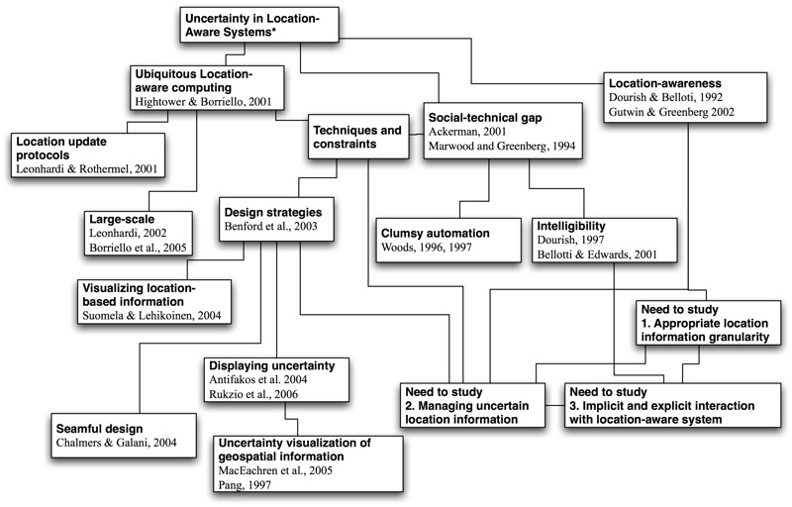
Literature Map

Slide 27
Activity
Using the ideas covered so far, read one of the following papers:
Undefined By Data: A Survey of Big Data Definitions
http://arxiv.org/abs/1309.5821
An Introduction to Knowledge Management
http://arxiv.org/abs/0812.0438
Open Source Software and Peer Review
http://arxiv.org/abs/cs/0308040
What do you think the paper is about?
What questions did you ask?
Is it Current, Reliable, Authoritative?
Is it Biased?

Slide 28
Open Source Software and Peer Review
Is it:
Current?
September 2003 → not current
Reliable?
Only 3 references, 1 is unrelated, 1 is irrelevant
Was not peer-reviewed (it’s not a conference/journal article)
Authoritative?
Who is the author? (missing affiliation)
Does not demonstrate expertise
Biased?
Totally! ☺
Tone is too strong, impartial, first person, statements without support from proper citations

Slide 29
Undefined By Data: A Survey of Big Data Definitions
Current?
Yes (September 2013)
Reliable?
Some “acceptable” references
Was not peer-reviewed (it’s not a conference/journal article)
Authoritative?
Affiliation from a computer science school in a UK university
Ambiguous
Biased?
Try to compare and contrast several definitions and wrap up a summary in the end

Slide 30
Assignment
Journal articles (long-existing journals, recent articles)
Publishers: Elsevier, Taylor & Francis, Sage…
Impact factor
Conference papers (international, (English), long-existing conferences, recent articles)
ACM, IEEE etc.
Rankings
Famous authors, schools, organizations…

